Slide 1
In-Vehicle Coupon Recommendation System Using Machine Learning
DATA 606 Capstone
Under the guidance of Professor,
Dr. Chaojie Wang
Saathyak Rao Kasuganti – FV86010

Slide 2
Introduction
Goal : This project aims to predict whether individuals will accept coupons in different driving scenarios
Expected Insights : How businesses/ entrepreneurs can customize their marketing strategies based on the identified factors influencing coupon acceptance?
Research Question/s:
What are the major factors that influence an individual's decision to accept or reject a coupon in various driving scenarios?
How does general demographic criteria influence and relate to coupon acceptance in different driving scenarios?
Answer to these questions can inform marketing strategies, enhance customer engagement, and improve the effectiveness of successful coupon promotions.

Slide 3
Data – Source, Credibility and Attributes:
Source: UC Irvine Machine Learning Repository.
Credibility:
UCI reputed for providing high-quality datasets
Data originally sourced form Amazon Mechanical Turk.
Data Attributes:
Size: 2213 Kb
Shape: (12684, 24)
Type of Attributes : Primarily categorical in nature.
Attributes datatypes: Object, Integers.

Slide 4
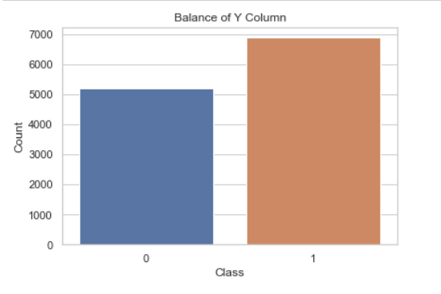
EDA: Type of Classification Problem

Slide 5
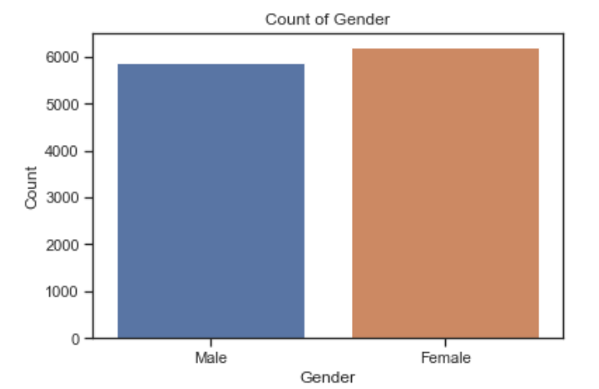
EDA: Distribution of Data – Gender distribution of survey

Slide 6
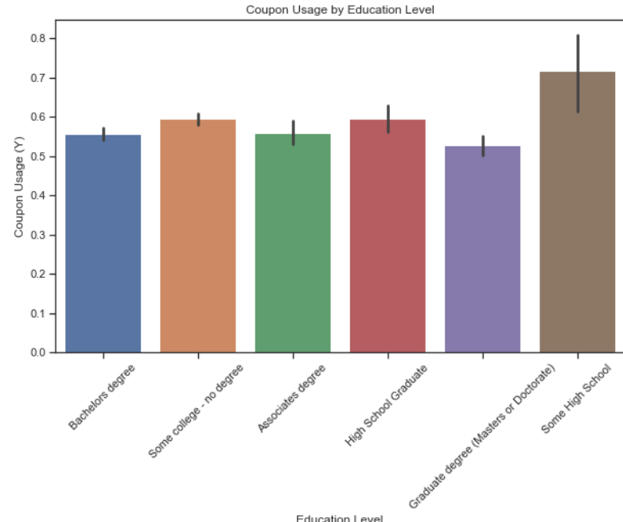
EDA: Distribution of Data – Education Level

Slide 7
EDA: Summary
There are 74 duplicated rows.
Columns with single entry – 1 Column, Dropped.
To control dimensionality – Column with 26 distinct values ‘Occupation’ is dropped.
Be aware of the increase in dimensionality when categories have a high cardinality (many unique values).
Use one-hot encoding that converts the existing categorical features to binary features, we can consider dropping the column 'occupation'

Slide 8
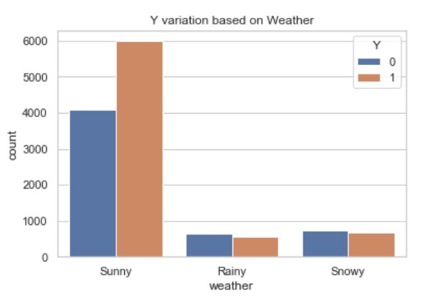
Insight: Coupon acceptance based on weather

Slide 9
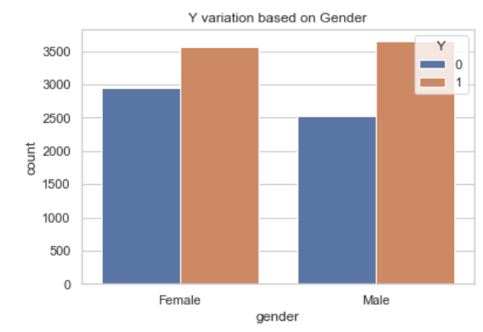
Insight: Coupon acceptance based on customer’s gender

Slide 10
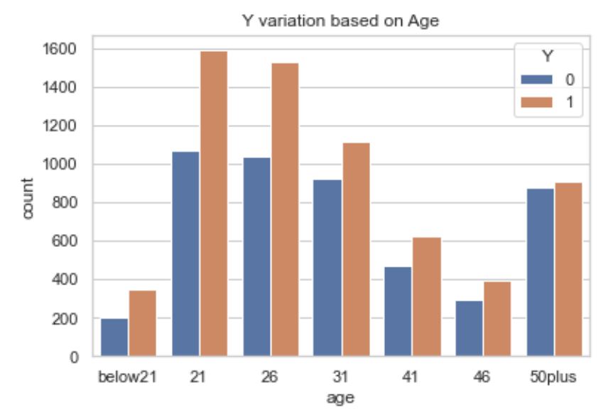
Insight: Coupon acceptance based on customer’s age

Slide 11
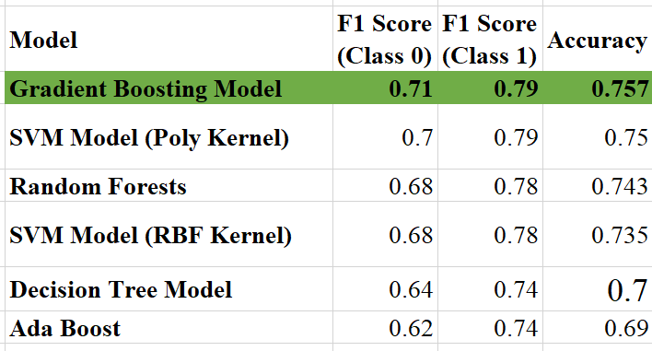
Results: Comparison of Model Performance.

Slide 12
Analysis : Why Gradient Boosting Model is Chosen?
High Accuracy (75.7%):
Achieved the highest accuracy among tested models.
Ensures dependable coupon recommendations.
Balanced F1 Scores:
Competitive scores for both successful (0.79) and unsuccessful (0.71) recommendations.
Ensures effectiveness across diverse scenarios.
Interpretability:
Offers transparency in prediction rationale.
Essential for trust and compliance.
Ensemble Learning:
Utilizes boosting to combine weak learners.
Reduces overfitting, captures complex patterns.

Slide 13
Analysis: Why Gradient Boosting Outperforms ?
Ensemble Learning:
Harnesses collective knowledge of weaker models.
Reduces variance, enhancing overall performance.
Reduced Overfitting:
Effectively handles overfitting.
Ensures model reliability compared to models with higher variance.
Generalization Capability:
Demonstrates excellent generalization.
Better accuracy in making recommendations on unseen data or new users.

Slide 14
Conclusion
Select the model based on the type of data.
Understanding the data – basic domain knowledge is critical. Helps in feature engineering. (Also control model complexity)
Occam's Razor: When 2 or more algorithms have similar accuracies, always prefer the simpler model.
The model can realistically never be able to reach 100% accuracy because of “Free will factor”.
This is not a biomedical or scientific use case. Only marketing purpose (Accuracy of 76% great)

Slide 15
THANK YOU

